Slide 1
History and Basic Concepts

Slide 2
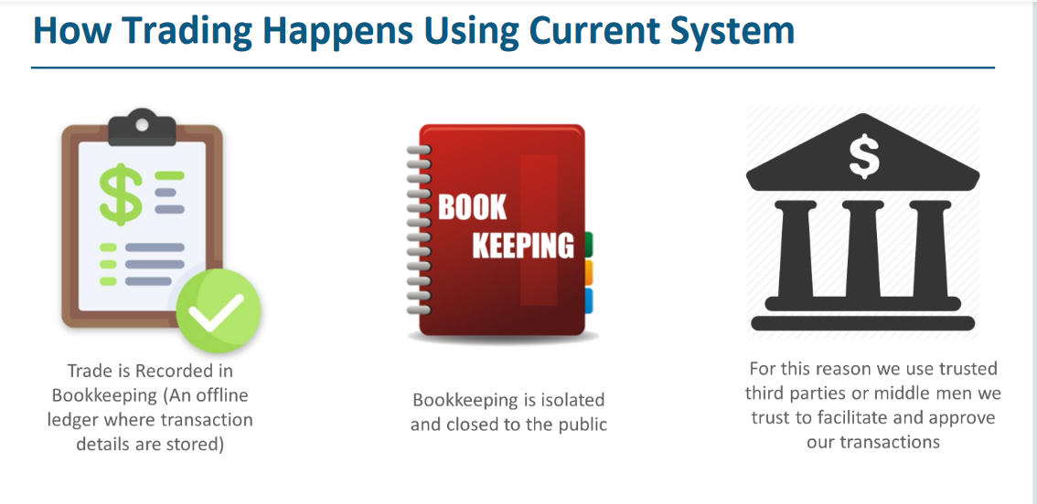

Slide 3
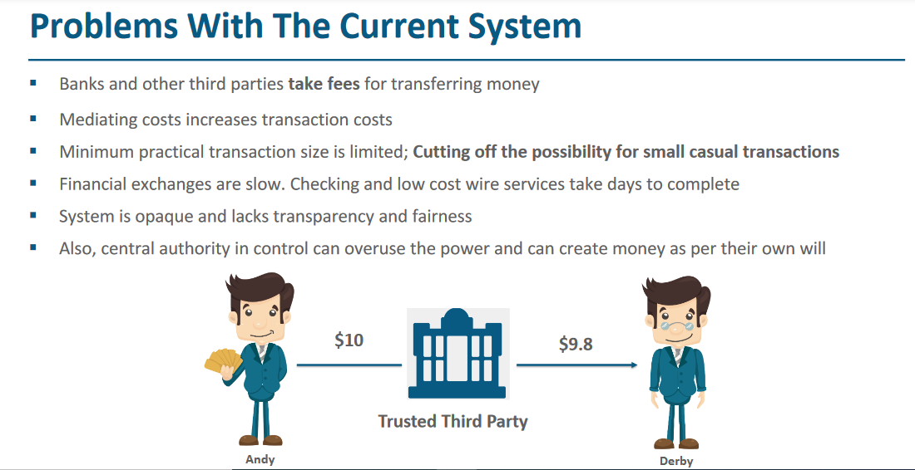

Slide 4
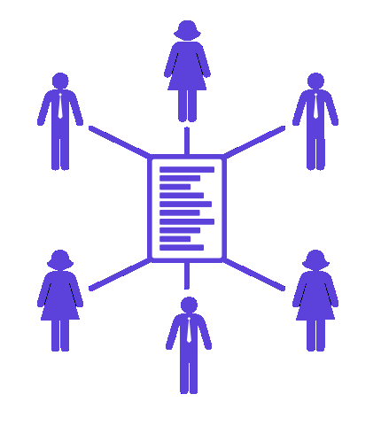
Challenges of Centralized System
Single point of failure
Prone to single cyber attack
Loss of data if server crashes
Insufficient Load Balancing
Governance under single control
If administrator play with logs/database

Slide 5
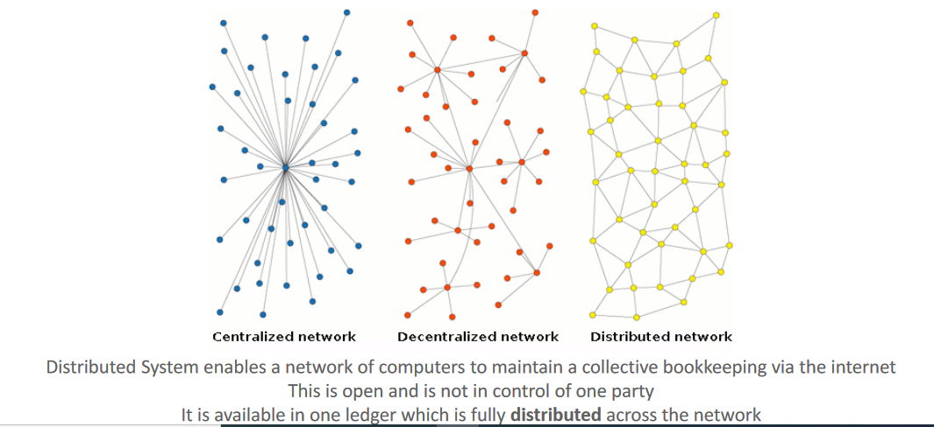

Slide 6
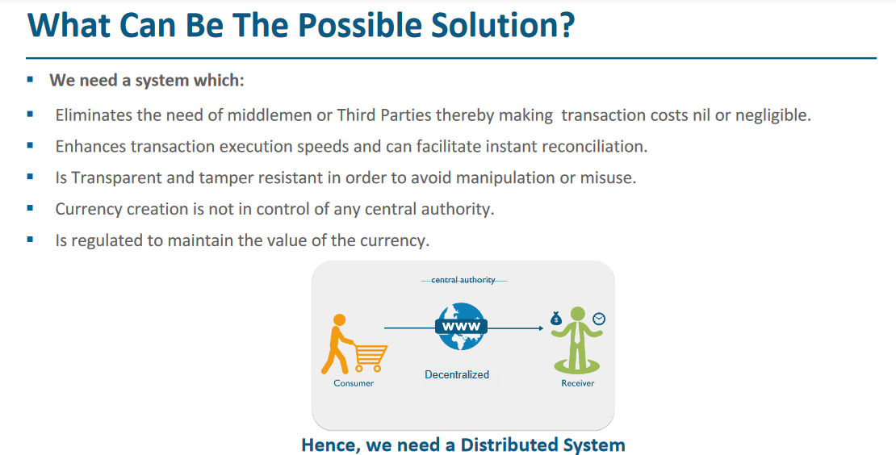

Slide 7
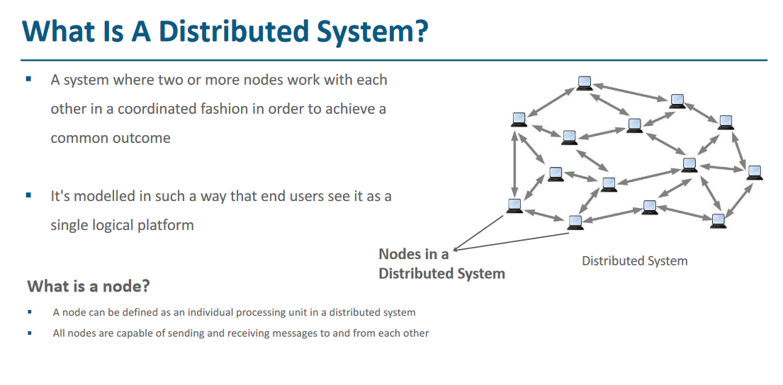

Slide 8
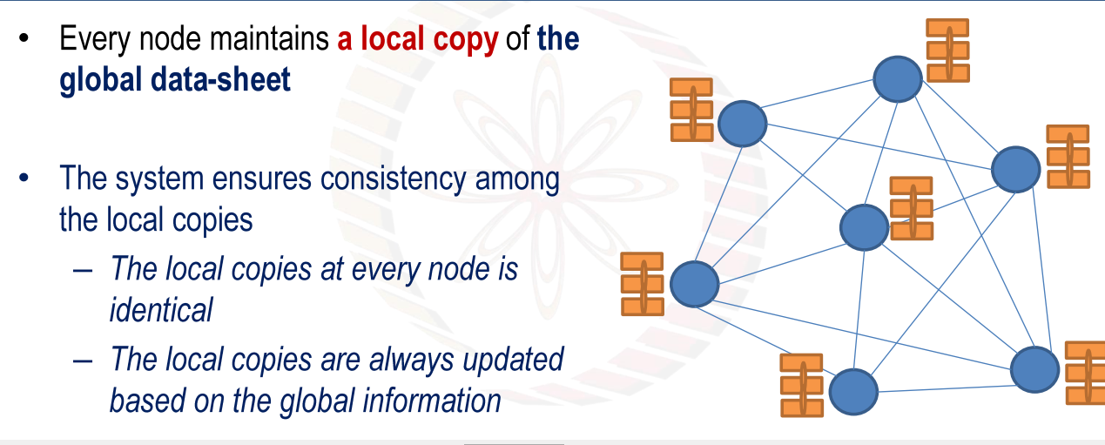

Slide 9
History

Slide 10
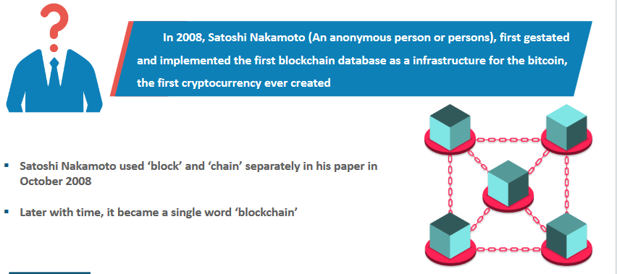

Slide 11
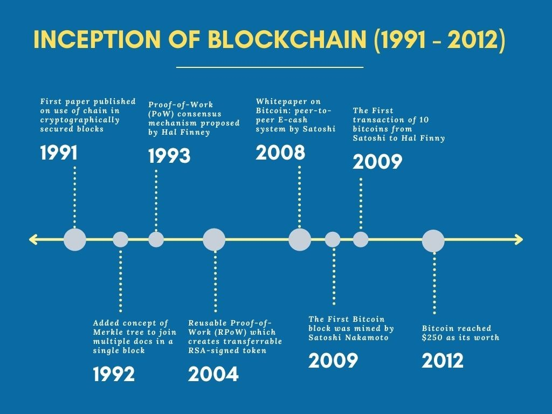

Slide 12
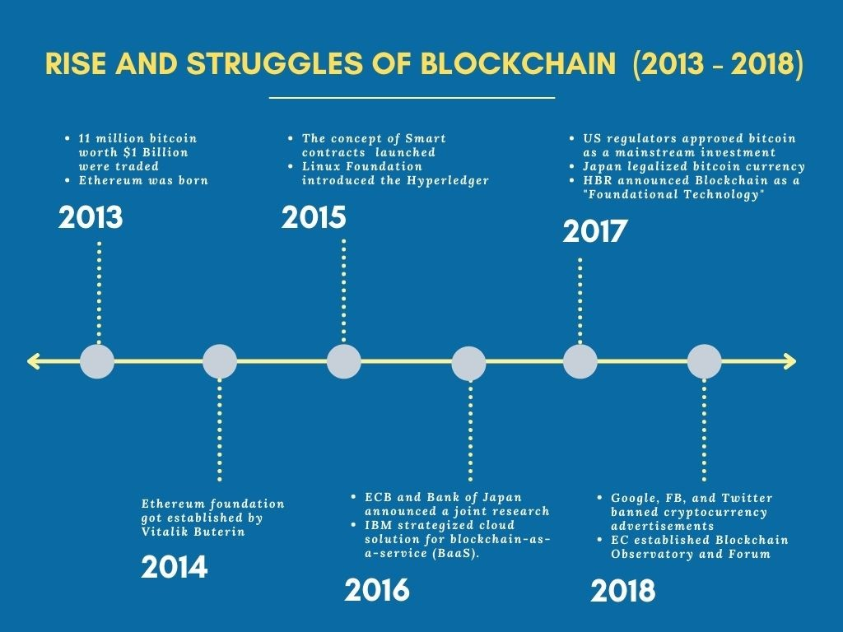

Slide 13
